Slide 1


BALLARI INSTITUTE OF TECHNOLOGY & MANAGEMENT
Autonomous Institute under VTU, Ballari-Hosapete Road, Allipur, Ballari583104
Karnataka ,India
Department of Artificial Intelligence & Machine Learning
A Major Project on
“NAMMA BUS”
SUCHITRA 3BR22AI158
V RAKSHITHA 3BR22AI178
YAMINI V 3BR22AI186
G ESHWAR 3BR23AI405
Head of Department
Dr. B M Vidyavathi
Professor & HOD
Dept. of AIML
Project Guide
Dr. B M Vidyavathi
Professor & HOD
Dept. of AIML
Project Coordinator Mrs. Asha Jyothi P Assistant Professor
Dept. of AIML

Slide 2
NAMMA BUS
Intelligent Transportation System Using Deep Learning
13/01/2026
Intelligent Transportation System Using Deep Learning
2

Slide 3
Abstract
The Intelligent Transportation System is a smart solution designed to improve transportation services for students and faculty by providing real-time bus tracking, ETA predictions, and automated alerts. Using GPS and IoT devices installed in college buses, the system continuously monitors location data and sends it to a backend server. A mobile and web app allows users to track buses live, receive notifications, and avoid delays.
The system integrates Deep Learning algorithms to analyze traffic patterns, predict arrival times, detect route deviations, and monitor driver behavior for safety.

Slide 4
Contents
1. Introduction
2. Problem Statement
3. Objectives
4. Scope Of The Project
5. Literature Survey
6. Domain(Area Of Work)
6.1 Core Domain
6.2 Application Domain
7. Proposed System
7.1 Architectural Design
7.2 Modules and their Functionalities
7.3 Existing and Proposed System
7.4 Flowchart
8. Methodology
8.1 Techniques
8.2 Developmental Model
8.3 Tools and Technologies
9. Requirements Specification

Slide 5
9.1 Functional Requirements
9.2 Non-Functional Requirements
9.3 Hardware Requirements
9.4 Software Requirements
10. Design
10.1 Block Diagram
10.2 Context Diagram
10.3 Use Case Diagram
10.4 Sequence Diagram
10.5 Activity Diagram
10.6 Entity-relationship Diagram
11. Testing
12. Results
13. Applications
14. Timeline
15. Future Scope
16. Conclusion
References

Slide 6
1.Introduction
Smart Bus Track is an intelligent transportation platform designed to enhance the daily commuting experience of college students and staff through real-time tracking and smart notifications. The system leverages GPS, IoT, and deep learning algorithms to improve functionality, safety, and operational efficiency. It connects students, drivers, and administrators through an integrated application for seamless transport management.

Slide 7
2.Problem Statement
This Project aims to design and develop a “INTELLIGENT TARNSPORTATION SYSTEM USING DEEP LEARNING” that uses IoT and deep learning to track college buses in real-time, predict delays, and notify students through a mobile/web app reducing waiting time and preventing missed buses due to unexpected delays.

Slide 8
3.Objectives
To track bus locations in real-time using GPS and IoT devices.
To save time for users.
To predict bus delays using deep learning algorithms.
To send smart notifications to users about delays and arrival times.
To develop a user-friendly app for live tracking and update.

Slide 9
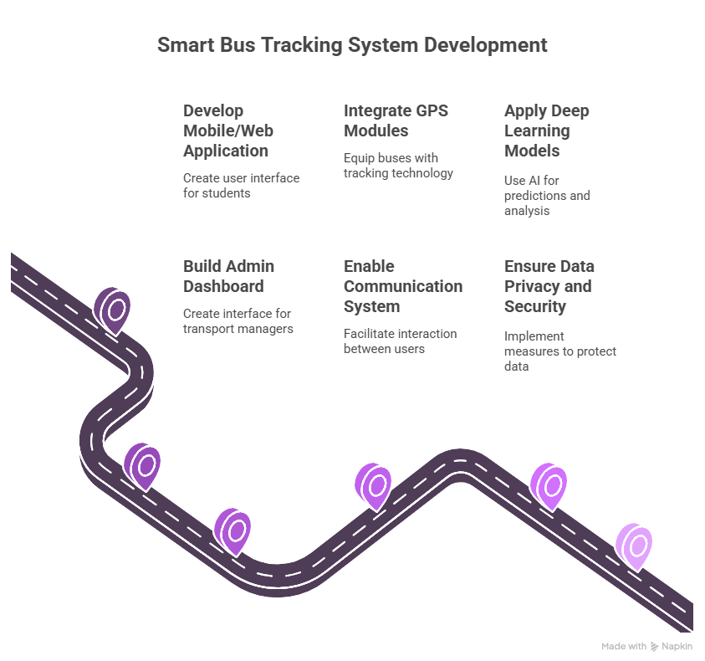
4.Scope of the Project

Slide 10
5.Literature Survey
Author & Title | Year | Summary | Key Findings
Narges Rashvand et al.-Real-Time Bus Departure Prediction Using Neural Networks for Smart IoT Public Bus Transit | 2025 | Uses neural networks and IoT data (GPS, weather, traffic) for accurate prediction of bus departure times. | Predicts departure with under 80 Seconds error; enhances smart transport efficiency.
Harshada Patil et al. – Bus Tracking System | 2025 | Developed a GPS-enabled web platform for live bus tracking and ticket booking for MSRTC buses. | Enhances commuter convenience through real-time updates and admin control.
10

Slide 11
Author & Title | Year | Summary | Key Findings
Mohit Pawar, Khushi Bisht, Anmol Ojha – GPS Enabled College Bus Tracking System | 2025 | Designed a cross-platform college bus tracking app using React Native and PostgreSQL with real-time alerts. | Improves student safety, provides instant location updates, and streamlines admin operations.
Ashwini B.P. et al. – A Dynamic Model for Bus Arrival Time Estimation using Machine Learning | 2024 | Proposes a machine learning-based system to predict bus arrival times using traffic and location data. | ML models provide more accurate ETA compared to traditional methods.

Slide 12
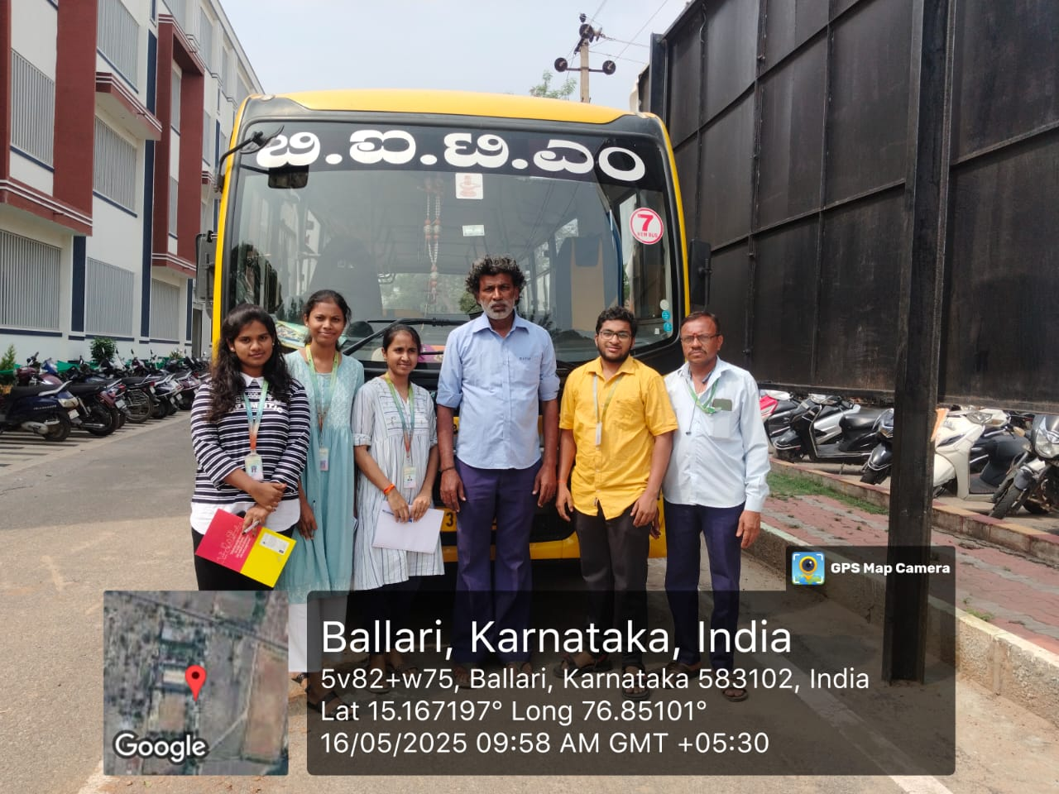
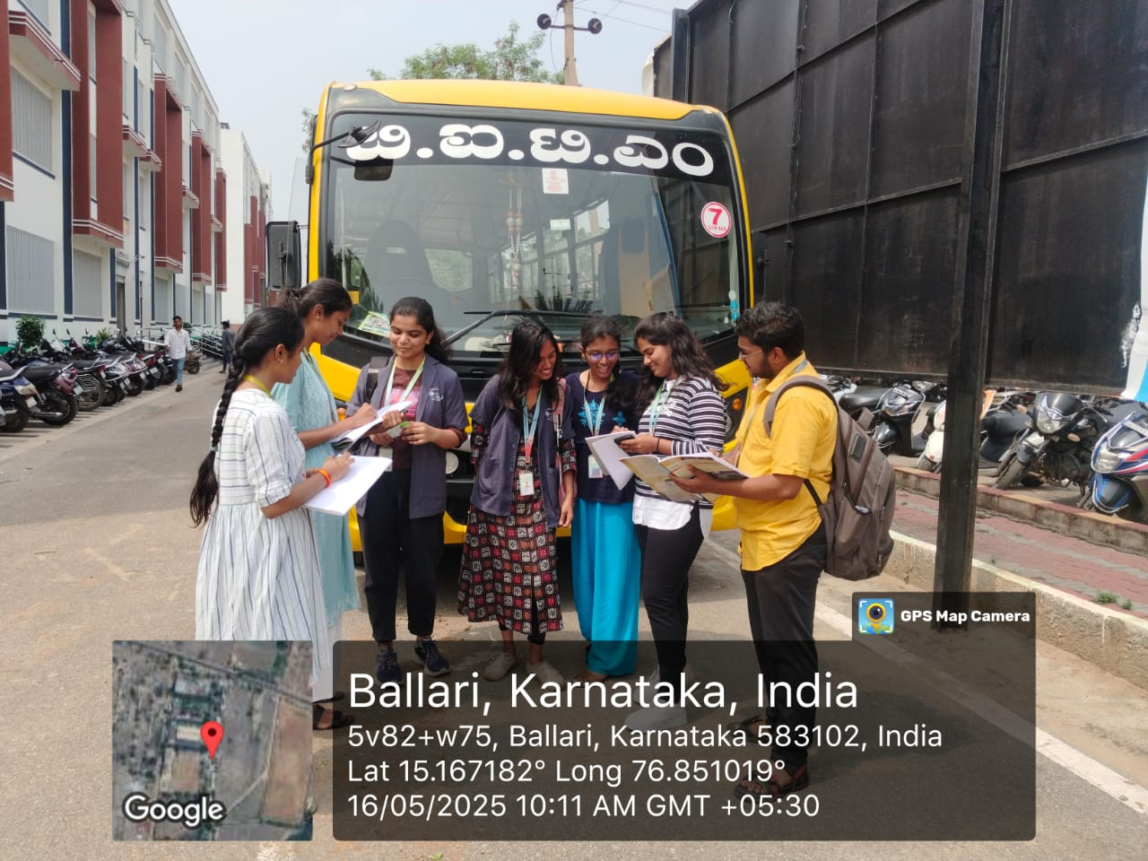
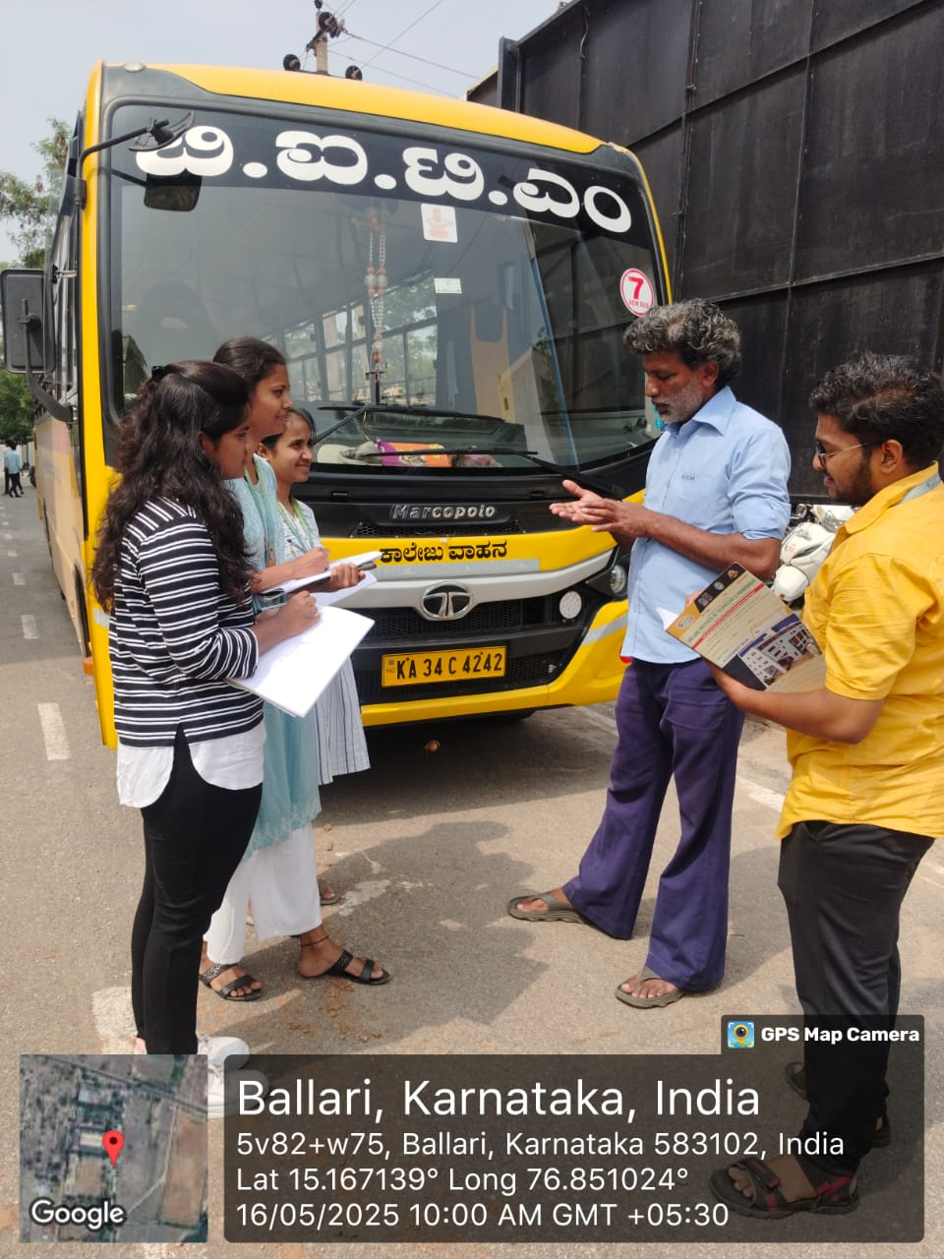
Survey..

Slide 13
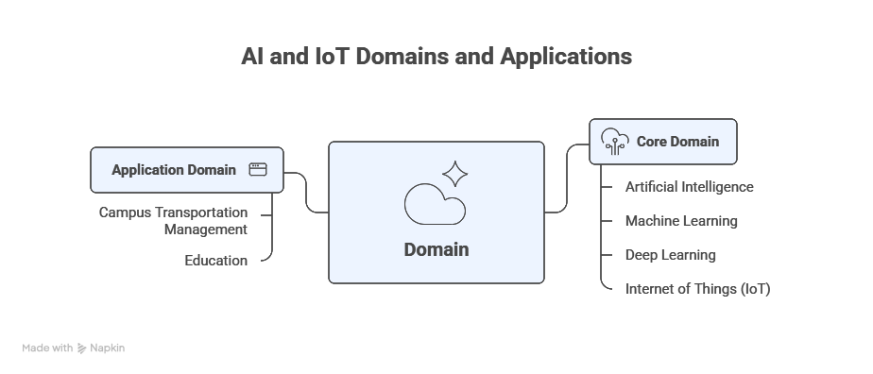
6.Domain
13

Slide 14
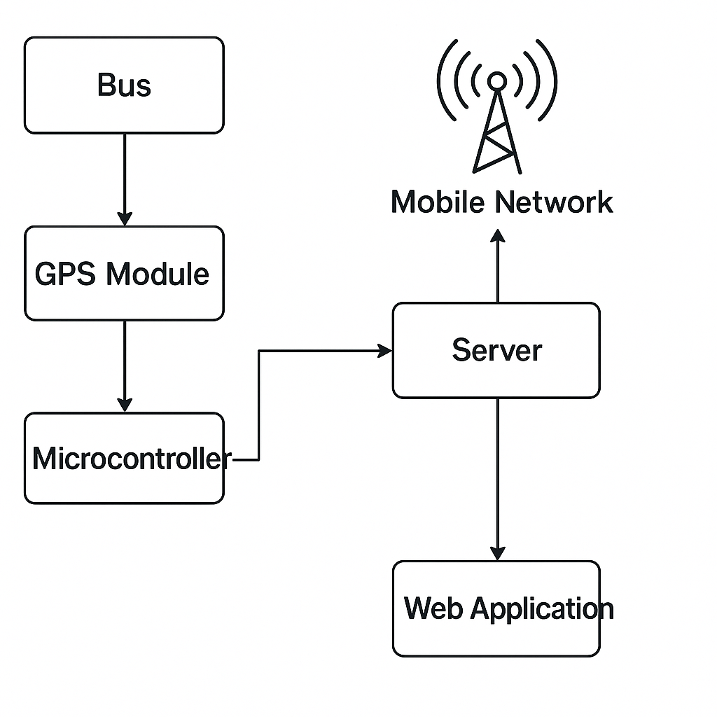
7.Proposed System
7.1 Architecture diagram

Slide 15
7.2 Modules and their functionality
Data Collection Module.
Data Preprocessing Module.
Delay Prediction Module.
User Interface Module.
Admin Dashboard Module.

Slide 16
7.3 Existing System Vs Proposed System
S. No | Existing System | Proposed system
01 | No real-time tracking | Live GPS-based bus tracking
02 | No ETA or delay prediction | Deep learning-based ETA and delay alerts
03 | Students wait without updates | Real-time location and ETA on student app.
04 | Inefficient admin monitoring | Centralized admin dashboard for bus and route management

Slide 17
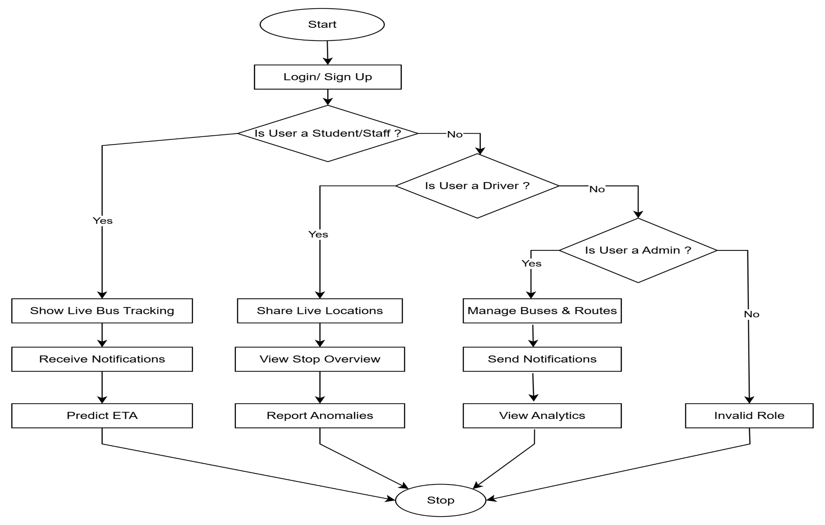
7.4 Flow Chart

Slide 18
8. Methodology
8.1 Techniques or Algorithms to be Used
GPS-Based Real-Time Tracking→ Tracks bus location live using GPS devices installed in buses.
IoT Integration→ Collects and transmits bus movement data (location, speed) to the backend server.
Deep Learning for ETA Prediction→ Predicts estimated arrival times using historical and real-time data.
Firebase Cloud Messaging (FCM)→ Delivers instant push notifications to students about delays or arrivals.
18

Slide 19
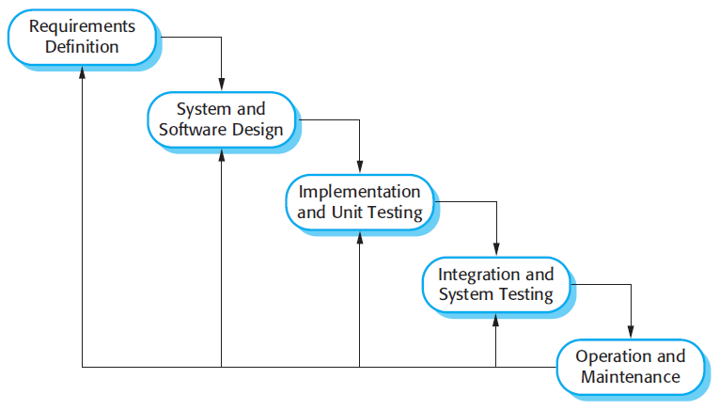
8.2. Development Model
Waterfall Model: Our project follows a plan-driven approach, and the most suitable development model is the Waterfall (or V-Model), as it allows structured, sequential development and systematic testing of software components.

Slide 20
8.3 Tools & Technologies
Frontend: React.js
Backend: Node.js
Database: MongoDB (for storing user data, bus schedules, GPS logs, etc.)
Notification System: Firebase Cloud Messaging (FCM)
Tools & IDEs: Visual Studio Code
Geolocation : Google Maps

Slide 21
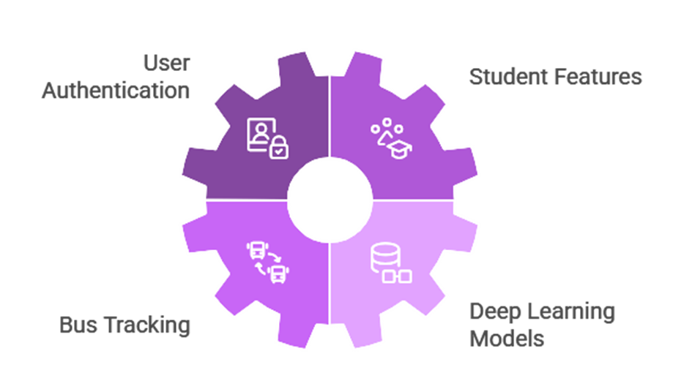
9.Requirements
9.1 Functional Requirements

Slide 22
9.2 Non-Functional Requirement
Performance
Scalability
Reliability
Security

Slide 23
9.3 Hardware Requirements
GPS Module
Network Module (e.g., ESP32 )
Smartphone or PC (for users)

Slide 24
9.4 Software Requirements
Frontend: React.js
Backend: Node.js
Development Tools: Android Studio
Maps: Google Maps API
Database: Mysql (for storing users, routes, bus info, GPS logs)

Slide 25
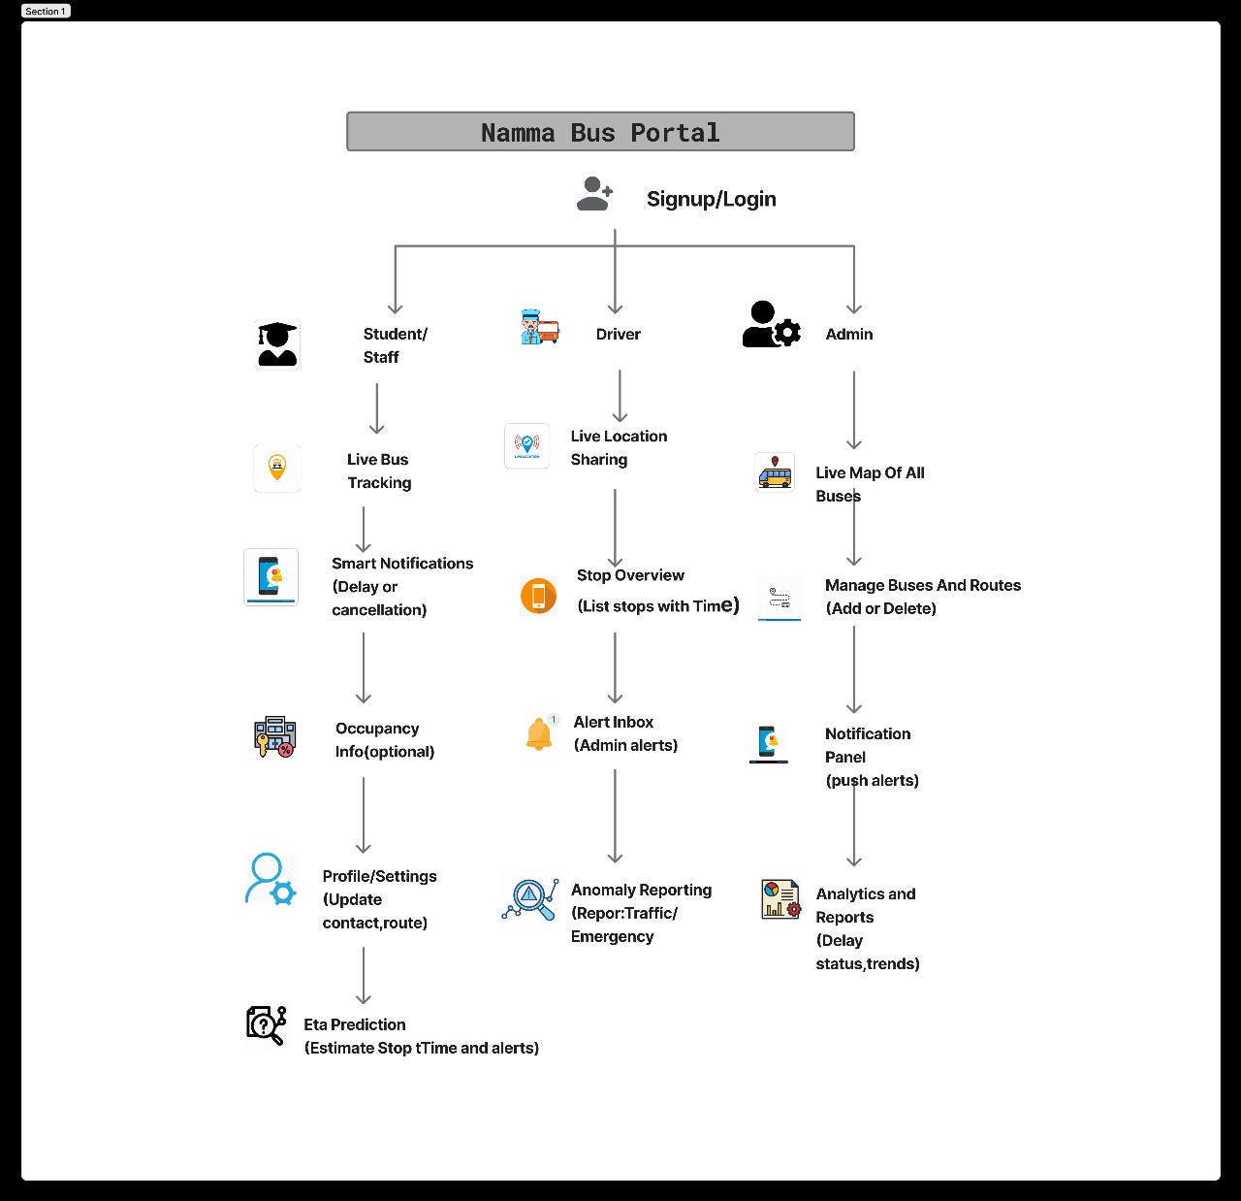
10.Design
10.1 Block Diagram

Slide 26
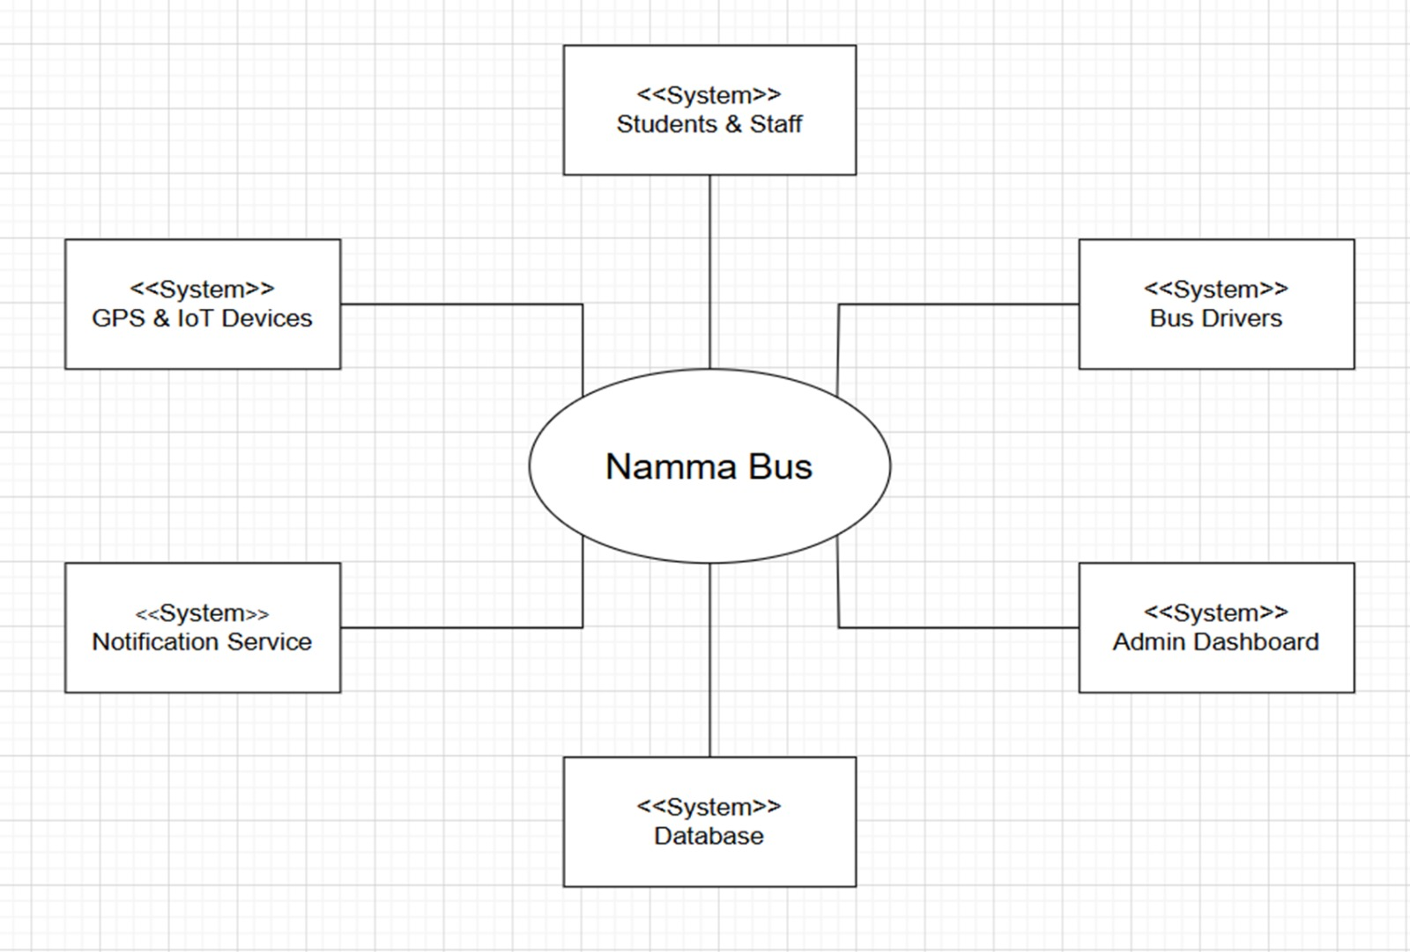
10.2 Context Diagram

Slide 27
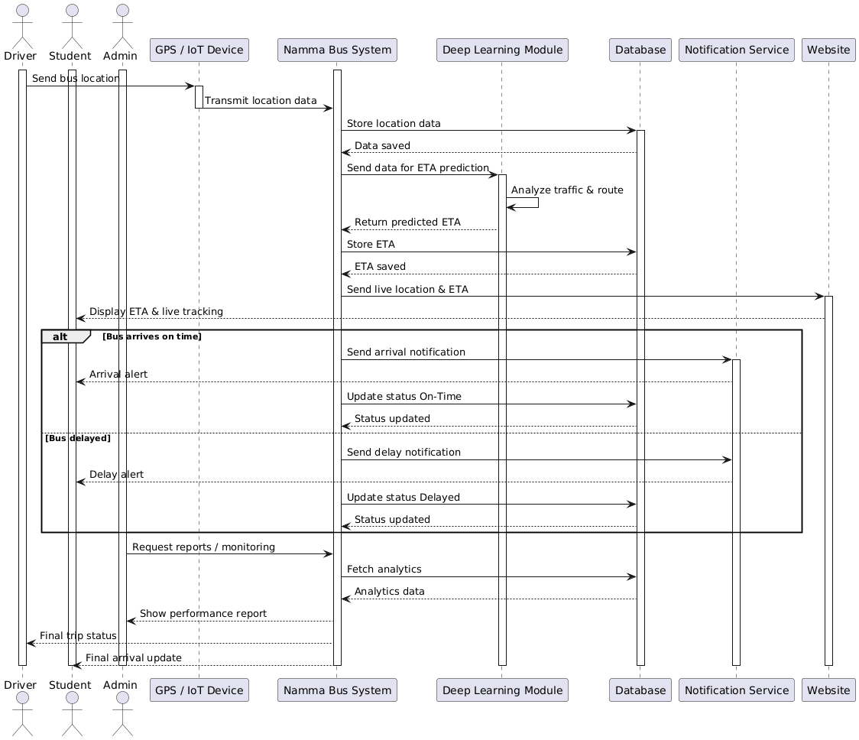
10.3 Sequence diagram
27

Slide 28
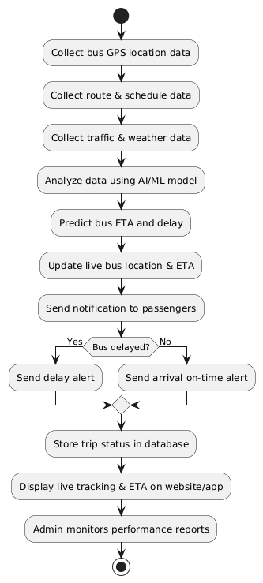
10.4 Activity Diagram

Slide 29
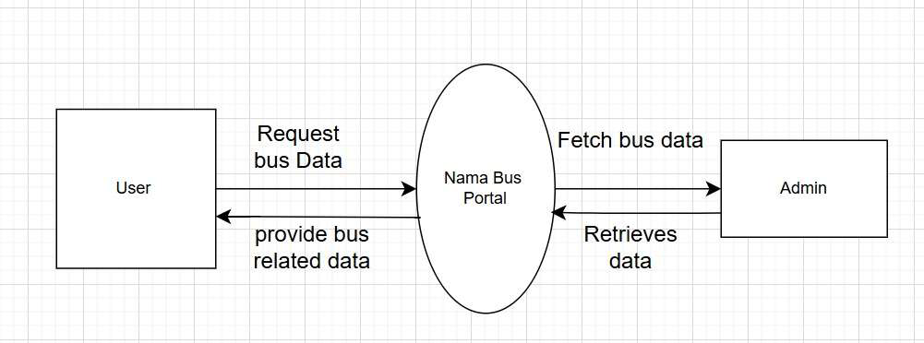
10.5 Dataflow Diagram

Slide 30
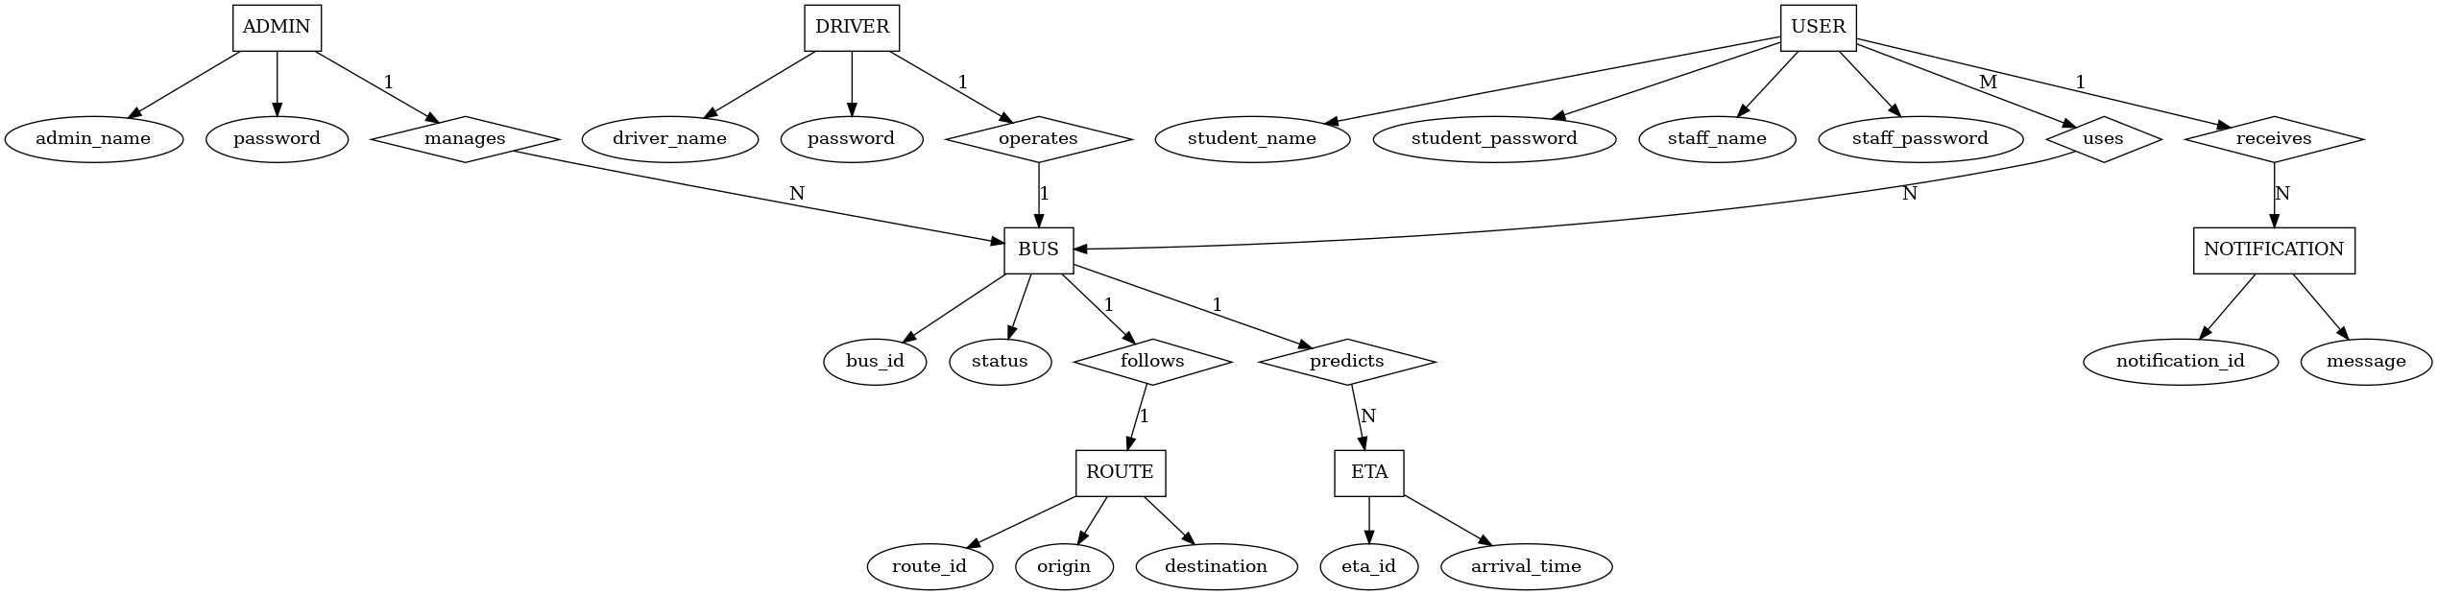
10.6 ER Diagram

Slide 31
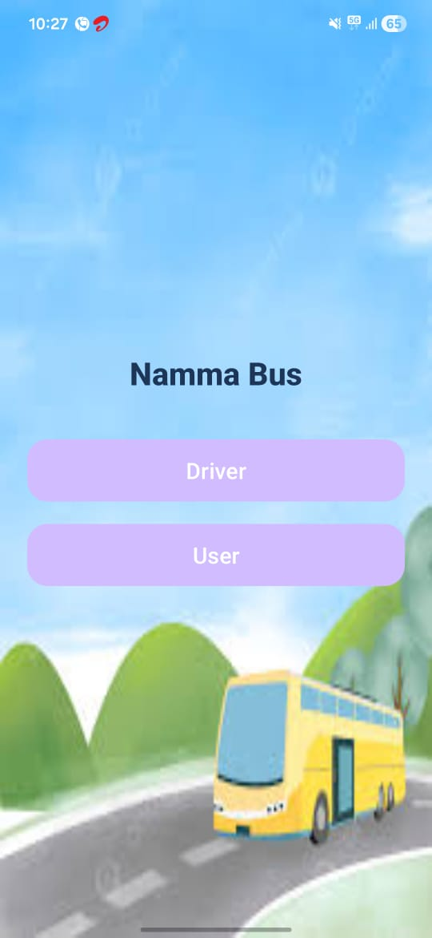
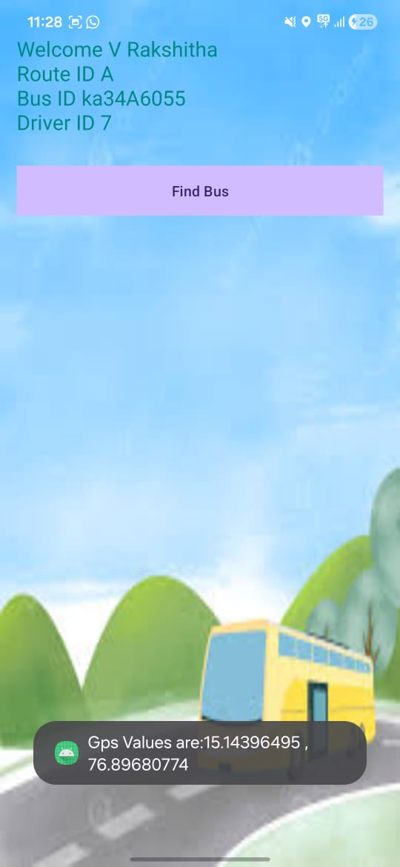
11. Results
Figure No 11.1: Homepage Interface
11.2: Find Bus Interface with GPS Location

Slide 32
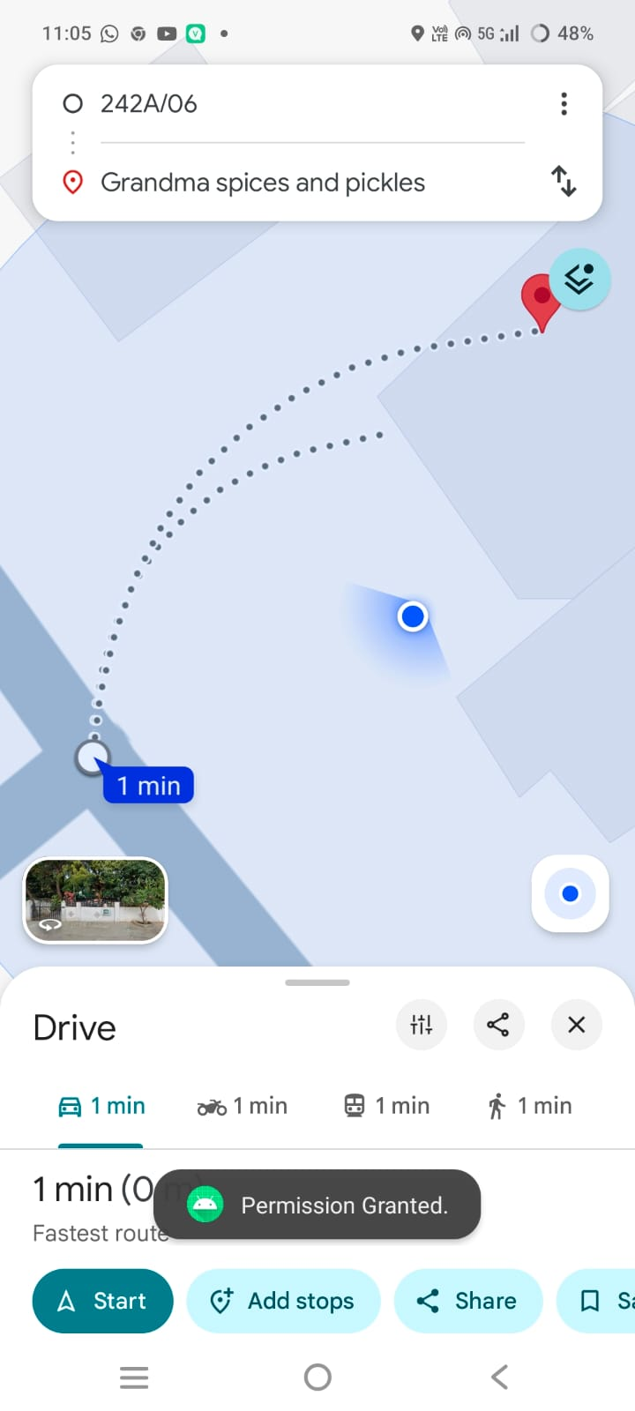
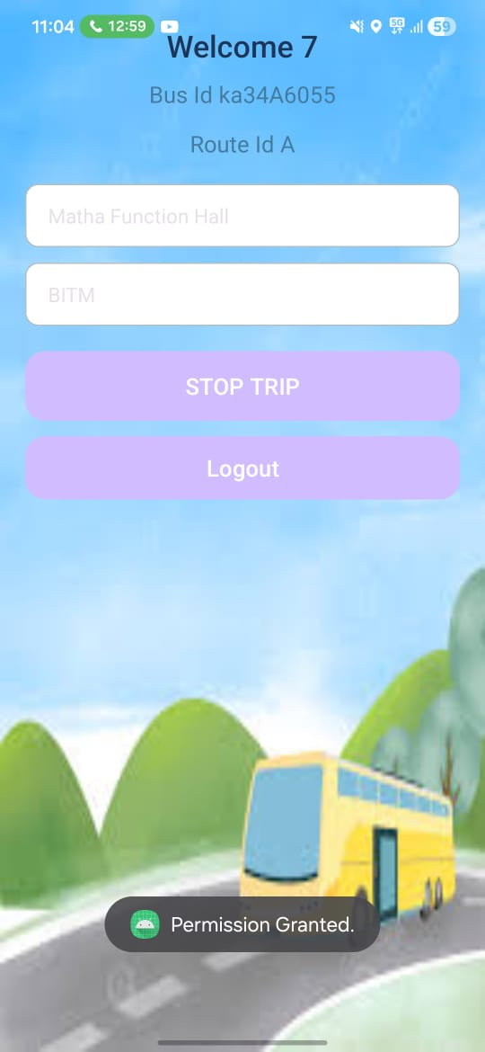
Figure No 11.3: Live Tracking
Figure no 11.4: Driver Dashboard Interface with Trip Control

Slide 33
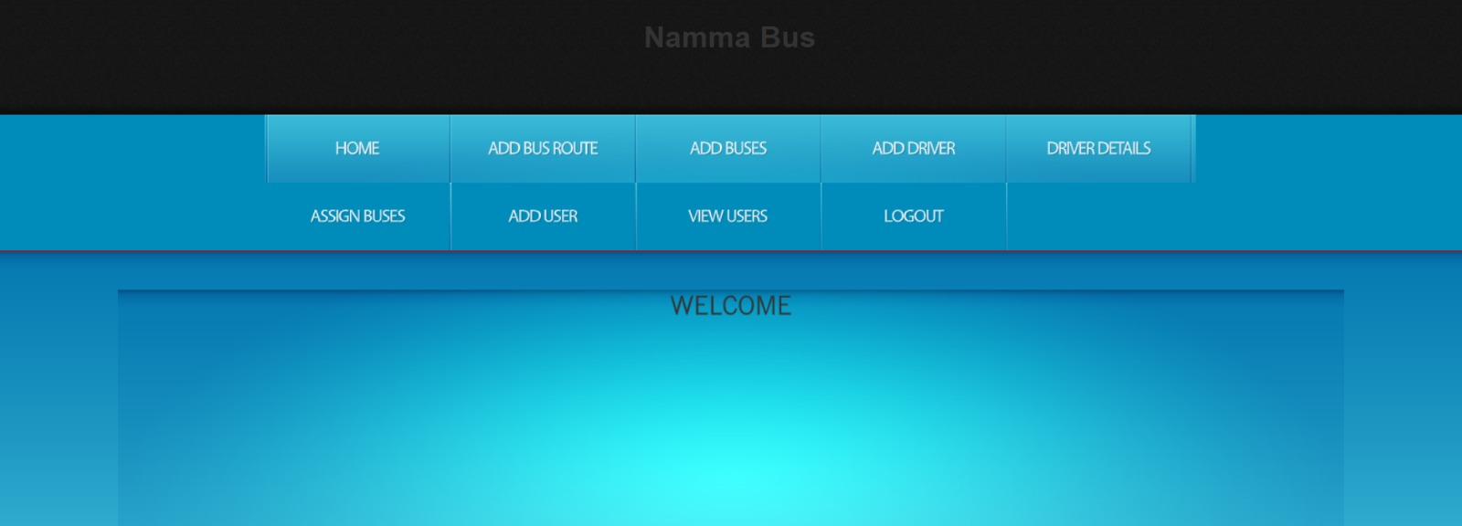
Figure No 11.5: Admin Dashboard
33

Slide 34
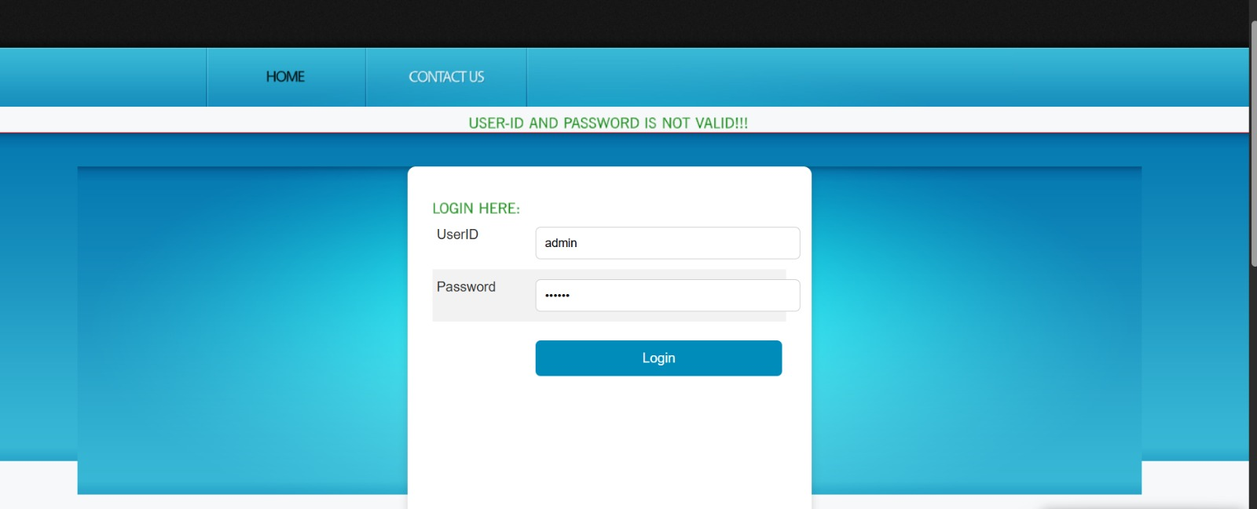
Figure No 11.6: admin Login Interface with Validation Message

Slide 35
12.Designing Test Cases
Test Case ID | Input | Description | Expected Result | Pass/Fail
TC_01 | Empty email field | User leaves the email field empty and clicks “Login.” | Validation message displayed: “Email is required.” | Pass
TC_02 | Empty password field | User leaves the password field empty and clicks “Login.” | Validation message displayed: “Password is required.” | Pass
TC_03 | Invalid credentials | User enters incorrect email or password. | Error message displayed: “Invalid email or password.” | Pass
TC_04 | Valid credentials | User enters valid email and password and clicks “Login.” | Login successful; user redirected to their respective dashboard (Donor/NGO/Volunteer). | Pass
35

Slide 36
Test Case ID | Input | Description | Expected Result | Pass/Fail
TC_05 | Admin login with valid credentials | Valid admin data admin@nammabus.com Password: Admin@123 | Admin dashboard displayed. | Pass
TC_06 | Admin login with invalid credentials | Incorrect password eg Password: Admin@321 | Access denied | Pass
TC_07 | Driver login with valid credentials | Driver enters an valid email such a eg driver01@nammabus.com | Driver dashboard displayed | Pass
TC_08 | Driver login with invalid credentials | Driver enters an invalid email eg driver.com | Login failed | Pass
TC_09 | Real-time bus location tracking | GPS: 15.1394, 76.9214. | Bus location shown on map | Pass

Slide 37
Test Case ID | Input | Description | Expected Result | Pass/Fail
TC_10 | Driver location update | Driver sends GPS coordinates | Location updated in backend | Pass
TC_11 | Admin views live bus status | Admin dashboard access | All active buses displayed | Pass
TC_12 | Display bus route information | Selected route: BITM → Ballari | Route details shown to users | Pass
TC_13 | ETA prediction for different routes | Route: College → City Center | Correct ETA displayed for selected route | Pass
TC_14 | Admin notification monitoring | Delay or emergency alert | Alert visible in admin dashboard | Pass
TC_15 | Driver route assignment | Assigned route by admin | Route assigned successfully | Pass

Slide 38
13. Future Scope
Integration with Smart Cities and IoT.
Voice and Vision Integration.
Collaboration with Public Policy and Governance.
Multi-modal Transport Integration.

Slide 39
14.Timeline
Phase | Description | Duration
1 | Synopsis + Literature Survey + Problem Statement | 6-8 weeks
2 | Design | 8 weeks
3 | Module Development | 4 weeks
4 | Integration + Testing + Final Report | 4 weeks

Slide 40
15. Conclusion
The Intelligent College Bus Tracking System offers a smart solution to improve campus transportation through real-time tracking, deep learning-based ETA predictions, and instant notifications. It enhances student convenience, ensures safety, and streamlines transport management, making college commutes more reliable and efficient.

Slide 41
References
[1] A. B. P. Ashwini, P. K. R. Manasa, B. G. Jyothi and M. V. Ramesh, “A Dynamic Model for Bus Arrival Time Estimation using Machine Learning,” International Journal of Engineering Trends and Technology (IJETT), vol. 70, no. 9, pp. 173–178, Sep. 2024. https://doi.org/10.14445/22315381/IJETT-V70I9P219
[2] N. Rashvand, S. S. Hosseini, M. Azarbayjani, and H. Tabkhi, “Real-Time Bus Departure Prediction Using Neural Networks for Smart IoT Public Bus Transit,” arXiv preprint arXiv:2501.10514, Jan. 2025. https://arxiv.org/abs/2501.10514
[3] H. Patil, S. Mali, P. Khivansara, A. Mokashi, D. Yadav, F. Sayyad, and V. Chougule, “Bus Tracking System,” UG Research Paper, Department of CSE, Bharati Vidyapeeth’s College of Engineering, Shivaji University, Kolhapur, India, 2025.

Slide 42
[4] M. Pawar, K. Bisht, and A. Ojha, “GPS Enabled College Bus Tracking System,” AIJRA - Asian Indexed Journal for Research in Applied Science, vol. VIII, issue IV, pp. 16.1–16.6, 2025. http://www.ijcms2015.co/vol-viii-issue-iv.html
[5] lan Sommerville, Software Engineering, Pearson Education ISBN 13: 978-0-13 703515- 9th Edition 2011 https://engineering.futureuniversity.com/BOOKS%20FOR%20IT/Software-Engineering-9th-Edition-by-lan-Sommerville.pdf.

Slide 43
Thank you…

